Slide 1
Automated AI Based Recruitment Pipeline
By
Hasini

Slide 2
Objective
Developed an AI-driven automated recruitment pipeline.
Implemented a Resume Screener to filter candidates for interviews.
Utilized AI to generate interview questions tailored to the job description.
Enabled AI agents or non-experts to conduct interviews.
AI evaluated candidate performance based on:
- Resume analysis
- Interview responses
- Job role requirements
AI autonomously made selection/rejection decisions.
AI automatically notified HR/Manager via email with candidate results.

Slide 3
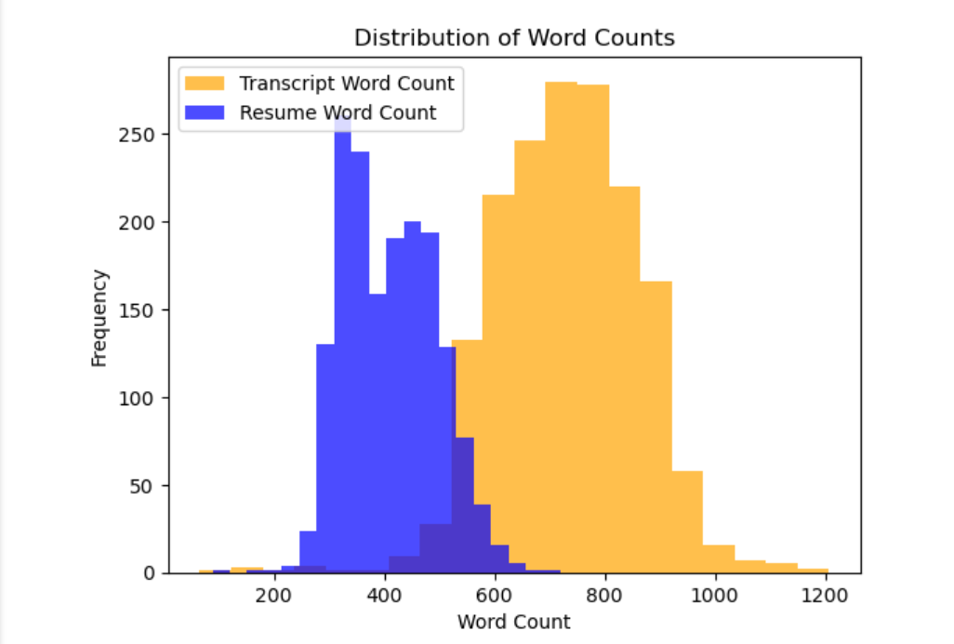
Exploratory Data Analysis (EDA)
Why EDA is Used in This Project
EDA was performed to understand the dataset, detect patterns, and identify potential data quality issues.
Helped in selecting the right features for training machine learning models.
Allowed us to visualize key insights such as decision distribution and resume characteristics.

Slide 4

Summary Statistics & Missing Values
- Performed Summary Statistics Analysis:
- Calculated mean, median, standard deviation for numeric features to understand data distribution.
- Handled Missing Values:
- Used a heatmap to visualize missing data.
- Identified gaps and cleaned the dataset for better accuracy.

Slide 5
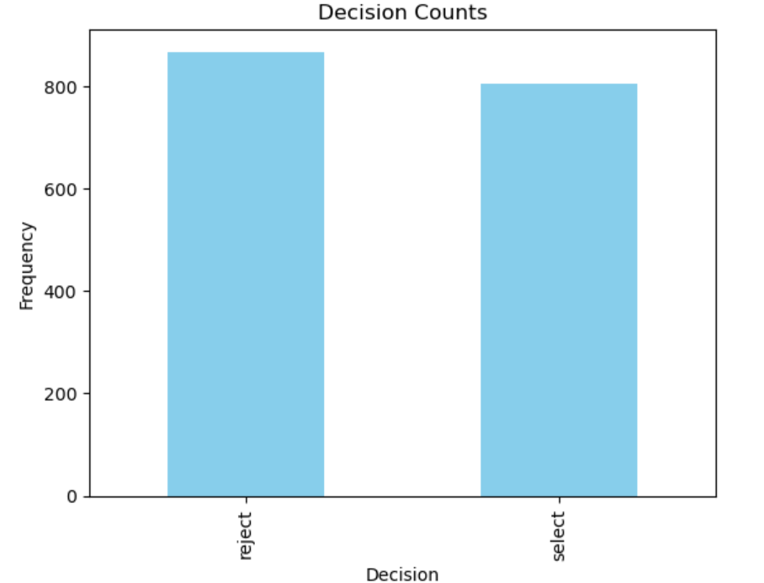
Correlation & Decision Counts
-Correlation & Decision Counts
- Conducted Correlation Analysis:
- Created a heatmap to find relationships between numerical features.
- Determined which factors influenced candidate selection.
- Visualized Decision Counts:
- Plotted a bar chart to display the number of selected/rejected candidates.
- Analyzed dataset balance for potential biases.

Slide 6
Model Training
Classical Machine Learning Models
Inputs: Resume-Job Description similarity, Resume-Transcript similarity, Transcript sentiment, Transcript subjectivity, Transcript length.
Output: Selection (1) or Rejection (0).
Feature Engineering & Selection:
Used TF-IDF vectorization for text similarity measurements.
Extracted sentiment and subjectivity from transcript data.
Computed transcript word count and weighted transcript similarity.

Slide 7
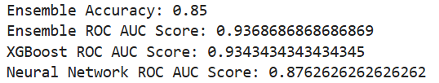
Results of ML Models
Model Performance
-Accuracy and ROC AUC scores visualized using bar plots.
- XGBoost achieved the highest accuracy and robustness.
- Feature Importance Analysis:
- Visualized the most impactful features using a feature importance plot.
- Resume-Job Description similarity and sentiment were among the top features.

Slide 8
Deep Learning (BERT-based model)
- Implemented BERT Embeddings:
- Used pre-trained BERT models for resume and transcript text analysis.
- Trained a Neural Network:
- Leveraged BERT embeddings for better contextual understanding.
- Compared with Classical Models:
- Achieved better accuracy in understanding text-based candidate qualifications.
- Outperformed traditional ML models in capturing semantic meanings.

Slide 9
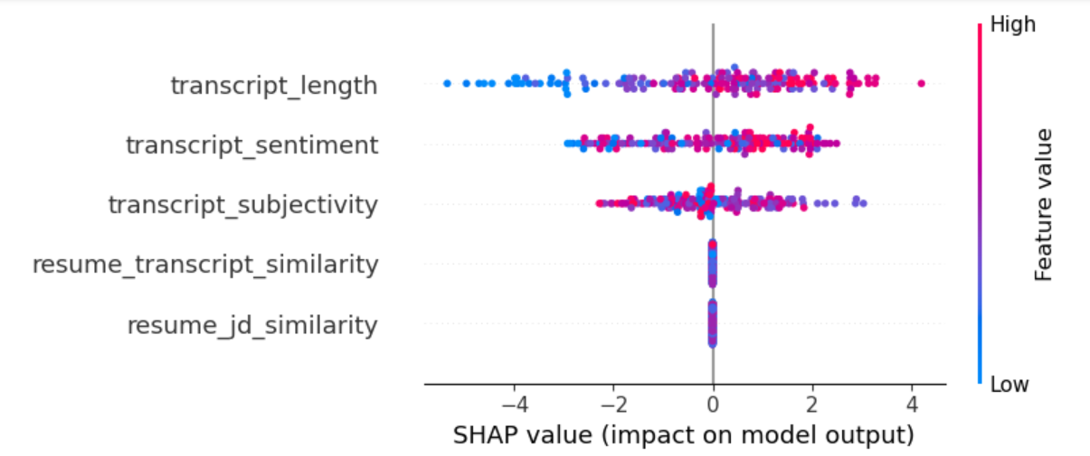
Post Model Analysis (SHAP Analysis)
Why SHAP Analysis?
- SHAP (SHapley Additive exPlanations) was used to interpret model decisions.
- Helps understand feature contributions to predictions.
- Ensures transparency in AI-driven selection processes.
SHAP Beeswarm Plot:
Visualized overall feature importance.
Highlighted the most influential features in the selection process.

Slide 10
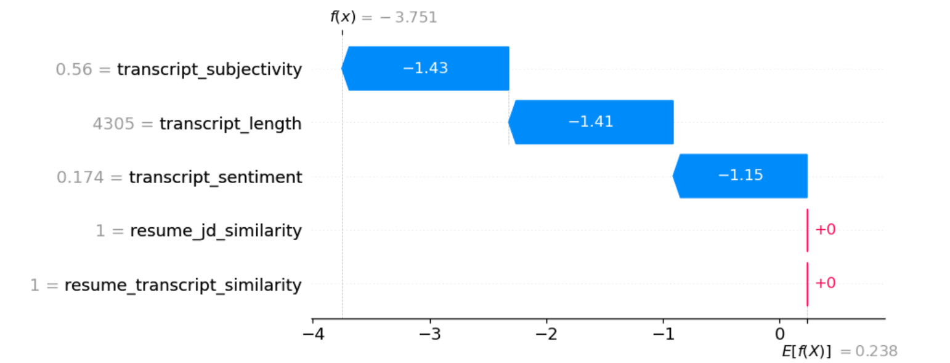
SHAP Detailed Analysis
SHAP Waterfall Plots:
-Generated for candidates with high, medium, and low predictions.
- Demonstrated how features influenced individual predictions.
SHAP Dependence Plots:
- Visualized relationships between top features and model output.
- Identified key trends in candidate selection.
Partial Dependence Plots (PDP):
- Showcased feature interactions using 1D and 2D plots.
- Further explained decision-making behavior.

Slide 11
Resume Screener Technique
Implemented Resume Screening Process:
- Utilized TF-IDF vectorization to extract text-based features from resumes, job descriptions, and transcripts.
- Measured cosine similarity between resumes and job descriptions to assess candidate relevance.
- Analyzed transcript similarity to evaluate alignment with job role.
- Screening Thresholds & Decision Making:
- Set similarity thresholds for resume and transcript screening.
- Classified candidates as **Accepted** or **Rejected** based on similarity scores.
- Adjusted thresholds dynamically to optimize selection criteria.

Slide 12
Prediction & Automated Email
Prediction Process:
- Used pre-trained XGBoost model to predict candidate selection.
- Computed resume-job similarity and transcript-job similarity using TF-IDF and cosine similarity.
- Applied model predictions to classify candidates as Accepted or Rejected.
- Saved results in prediction_results.xlsx for further analysis.
Automated Email Notification:
- Automatically sends results to HR with an Excel attachment.

Slide 13
Conclusion & Workflow
AI-Based Automated Recruitment Workflow:
1. Collect Resumes → Candidates submit resumes.
2. Screen Resumes (AI) → AI filters candidates based on similarity scores.
3. Select Candidates for Interview (AI)→ AI shortlists top candidates.
4. Generate Interview Questions (AI - LLaMA) → AI creates customized interview questions.
5. Conduct Interviews (AI or Human) → AI/human interviewer assesses responses.
6. Make Selection Decision (AI) → AI decides to select/reject candidat
7. Send Email Notification (AI) → AI sends results to HR.
Key Achievements:
Automated and optimized the recruitment process.
Reduced manual workload while ensuring fair, unbiased hiring.
Leveraged AI for intelligent decision-making and enhanced efficiency.

Slide 14
Thank You
HASINI
hasinib609@gmail.com

